Slide 1

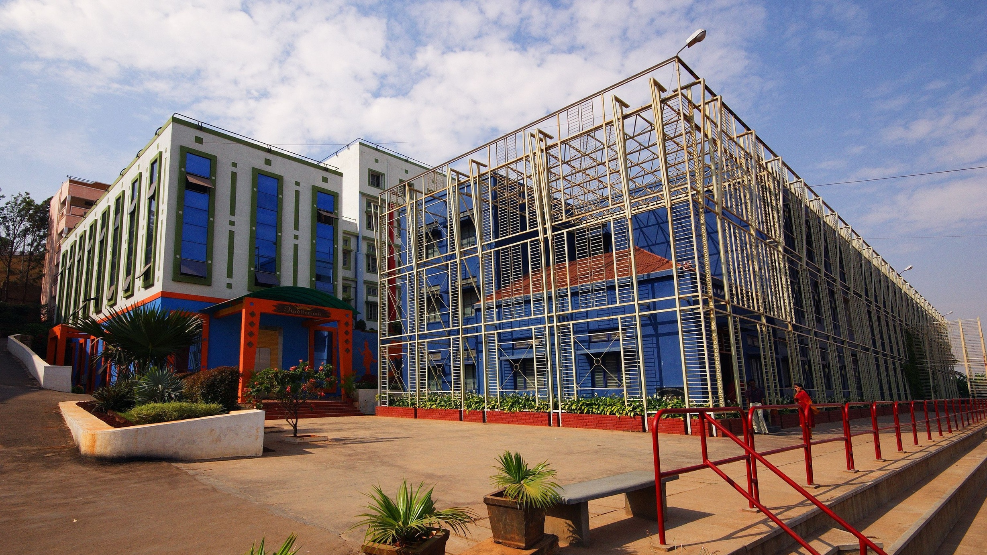

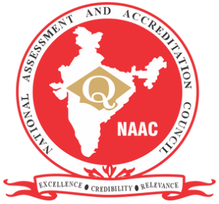
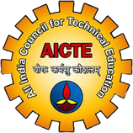
Sri Raghavendra Educational Institutions Society (R)
Sri Krishna Institute of Technology
(Approved by AICTE, Accredited by NAAC, Affiliated to VTU, Karnataka)
UNIVERSAL HUMAN VALUES
Right understanding :
Relationship and physical facilities
Presented By-
Adarsh Raj
Akshita K
Abhishesh sah
Abhijith barath
www.skit.org.in

Slide 2
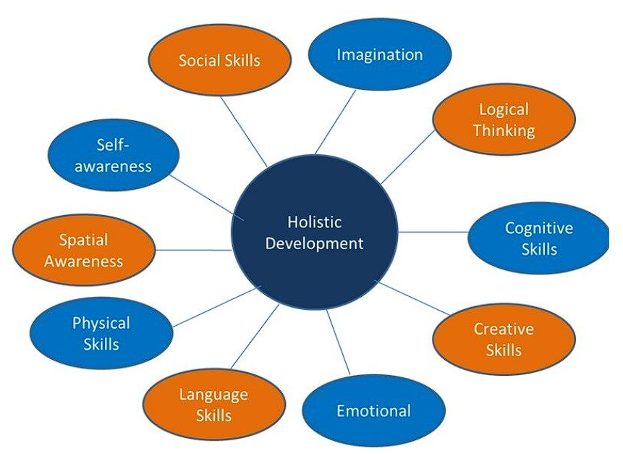
Introduction to Right Understanding, Relationship and Physical Facility (Holistic Development
Holistic development encompasses all aspects of an individual's well-being, including their relationships and physical environment.
Right understanding of relationships involves cultivating healthy and meaningful connections with oneself, others, and the world around them.
Physical facility refers to creating a conducive environment that supports individuals' overall growth and development.

Slide 3
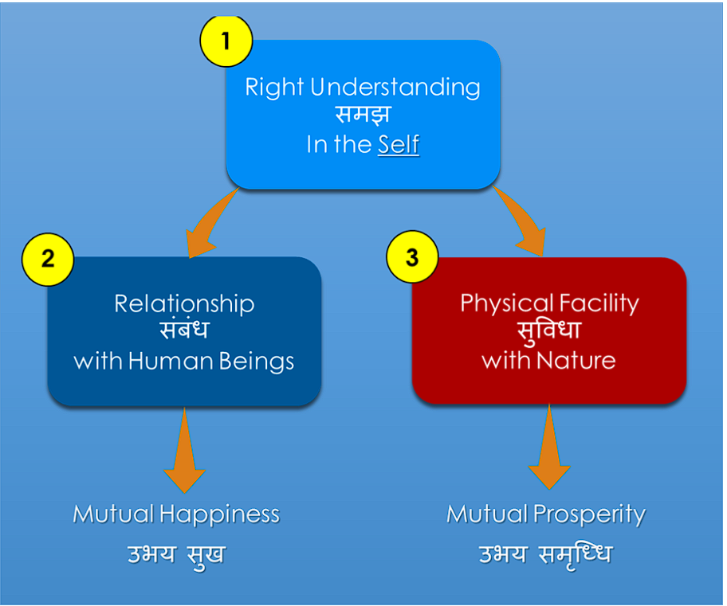
Basic Requirements for Fulfilling the Aspirations
•Right Understanding : This refers to higher order human skills the need to learn and utilize our intelligence most effectively.
• Good Relationships : This refers to the interpersonal relationships that a person builds in his or her life - at home, at the workplace and in society.
• Physical Facilities : This includes the physiological needs of individuals and indicates the necessities as well as the comforts of life.

Slide 4
Importance of Right Understanding , Relationship and Physical Facility
Developing right understanding of relationships relationships helps individuals build empathy, compassion, and effective communication skills.
A supportive physical facility promotes optimum physical, mental, and emotional well being.
Both aspects are essential for fostering holistic development and a balanced life.

Slide 5
Ex: Sitting in a hot room… you are uncomfortable & unhappy
Q: Does an AC help you resolve your discomfort & unhappiness?
An AC does help resolve the physical discomfort
However, it is not clear that the AC provides any
relief from unhappiness
Physical facility fulfills needs of the body
RIGHT UNDERSTANDING
in the self
1
RELATIONSHIP
with human being
Physical Facility
We can see that an AC has no impact in resolving contradiction in thoughts (physical facility does not have any impact on understanding in the self)
Only right understanding helps resolve contradiction in thoughts
2
3

Slide 6

Animal and Human Consciousness :
For Animals : Animals need physical things to survive, mainly to take care of their body.​Giving all priorities to physical facilities only, or to live solely on the basis of physical facilities, may be termed as 'Animal Consciousness’
For Humans : While physical facilities are necessary for human beings, Besides physical facilities, we want relationship. By relationship, we also crave meaningful relationships with family, friends, and others in our lives.
Living with all three : Right understanding, Relationship and Physical facilities is called 'Human Consciousness'.

Slide 7
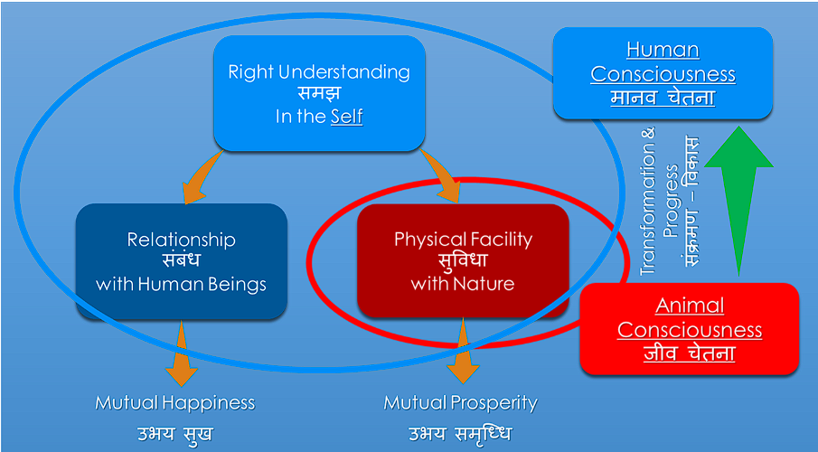

Slide 8
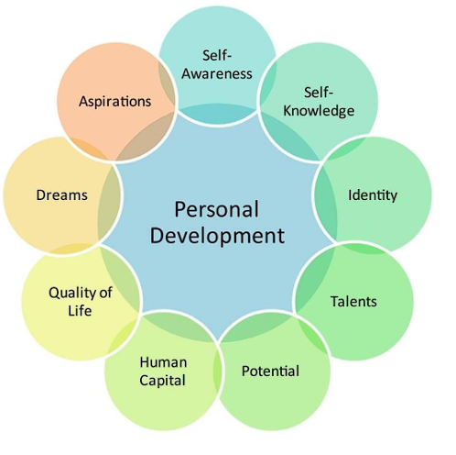
Enhancing Relationships for Holistic Development
Building self-awareness and self-compassion enables individuals to form healthy relationships with themselves.
Cultivating empathy and active listening skills fosters meaningful connections with others.
Nurturing respectful and supportive relationships leads to personal growth and overall well-being.

Slide 9

Creating a Supportive Physical Facility
A clean and organized physical space enhances focus, productivity, and overall mental well being.
Access to natural light, fresh air, and green spaces positively impacts physical and emotional health.
Incorporating ergonomic design and comfortable furniture promotes physical well being and reduces strain or discomfort.

Slide 10
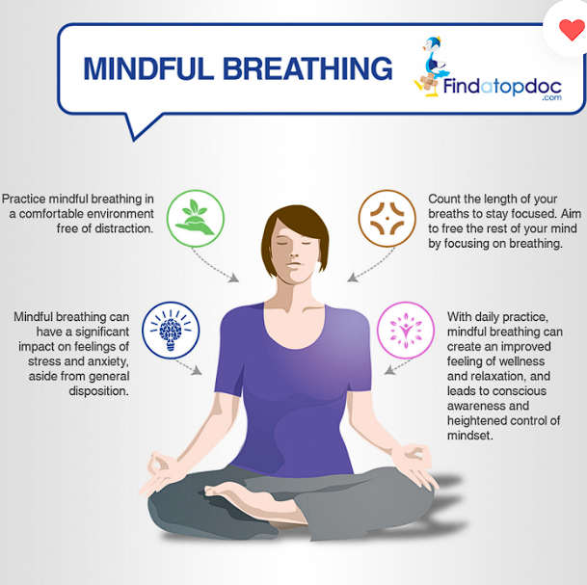
Promoting Mindfulness and Mind-Body Connection
Practicing mindfulness techniques, such as meditation or deep breathing exercises, enhances self-awareness and emotional regulation.
Incorporating physical activities and movement breaks throughout the day boosts energy, cognitive function, and overall well-being.
Encouraging a mind-body connection through activities like yoga promotes holistic development and stress reduction.

Slide 11
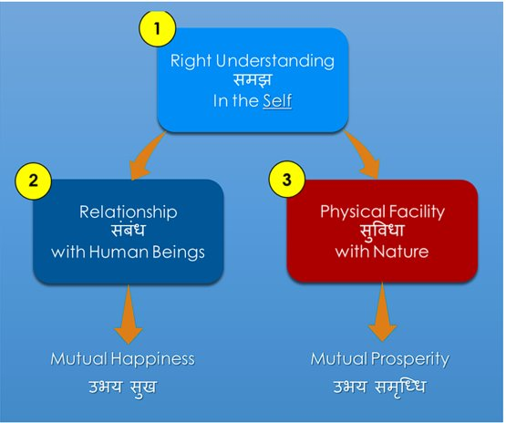
Conclusion
Right understanding relationship and physical facility are crucial elements in fostering holistic development.
Cultivating healthy relationships and creating a supportive physical environment contribute to overall well-being and personal growth.
By prioritizing these aspects, individuals can achieve a balanced and fulfilling life.

Slide 12


